Slide 1
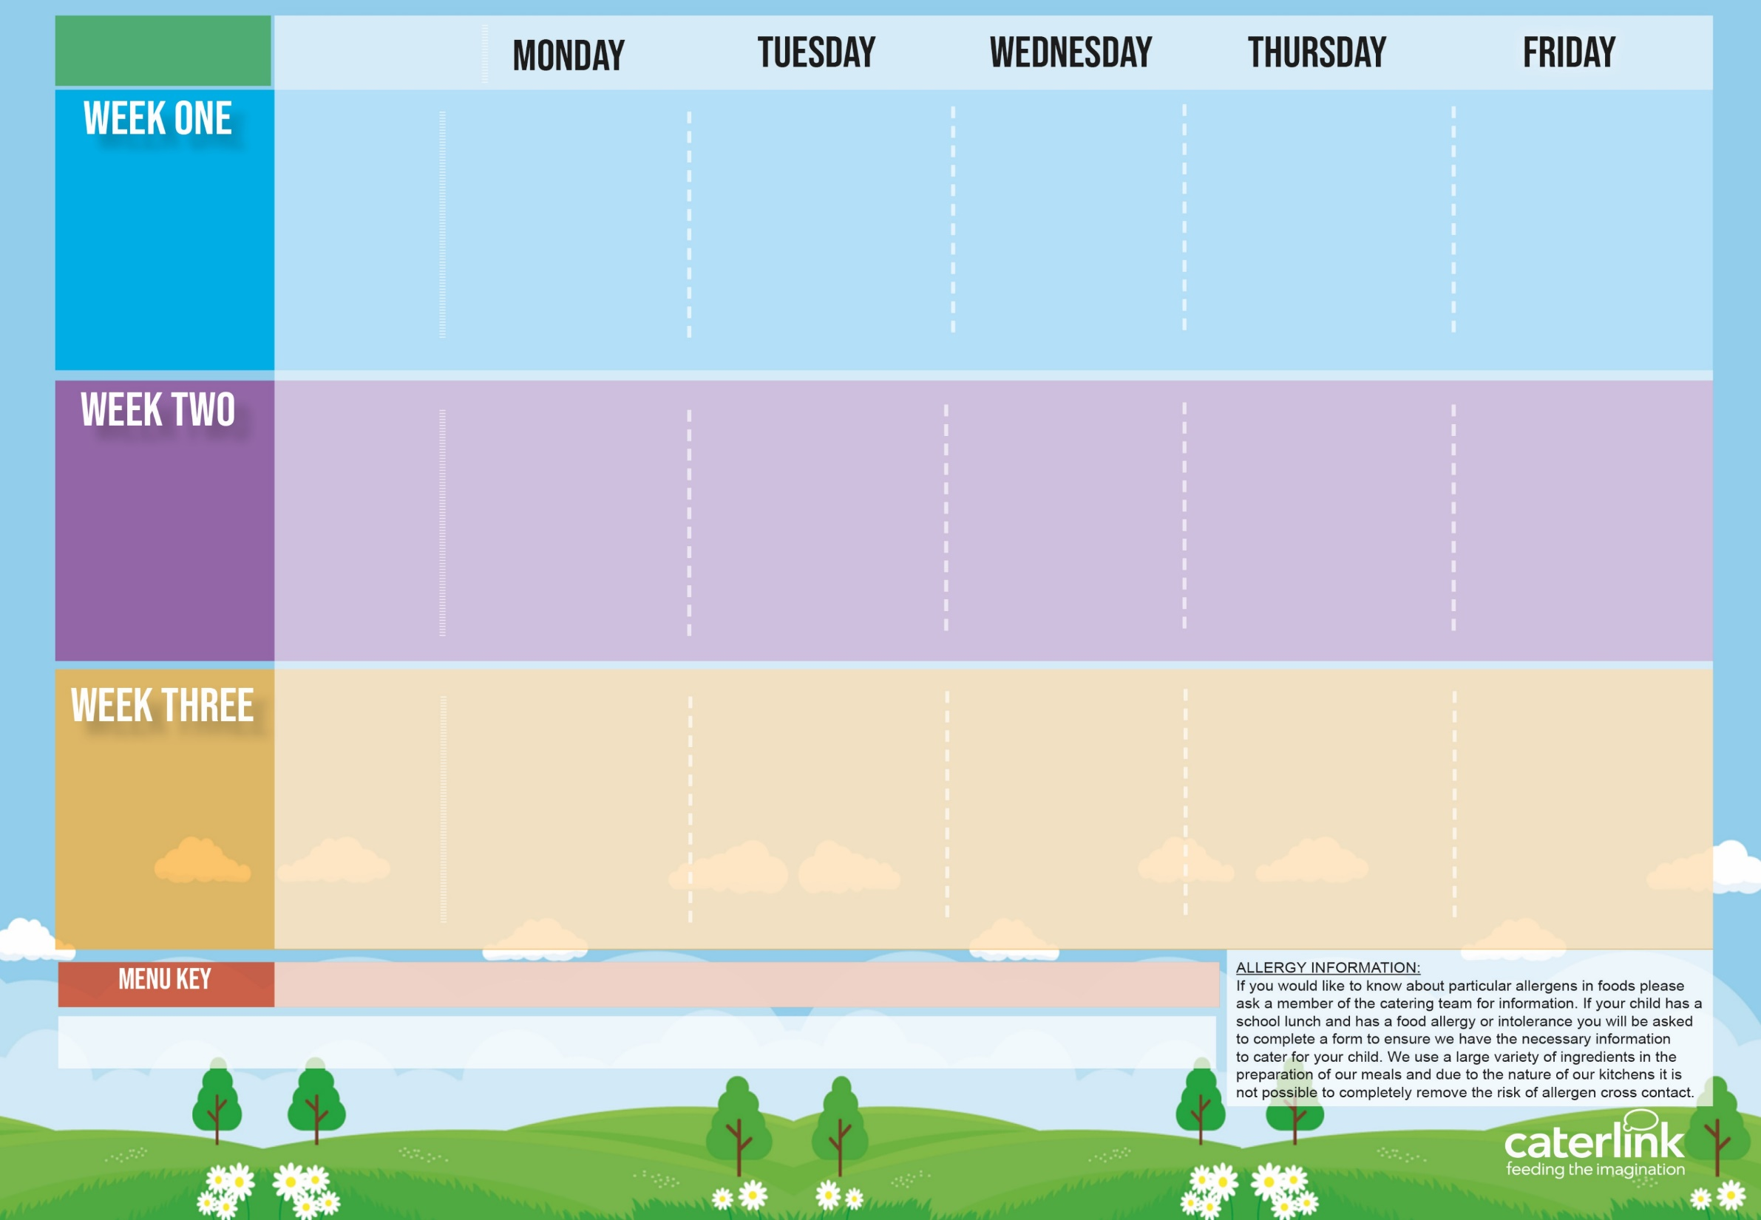
Spring Summer
2024
Option One
Option Two
Vegetables
Dessert
Cheese & Tomato Pizza | * Beef Penne Bolognaise | * Pork Sausages, Roast Potatoes & Gravy | * Chicken Paella Veggie Meatballs with Rice | MSC Fishfingers with Chips & Tomato Sauce
Vegetable Stack with Rice | Vegan Penne Bolognaise | Vegan Sausages, Roast Potatoes & Gravy | or Cheese Whirl with *Rice and Salads | Cheese Whirls with Chips
Peas & Roasted Peppers | Broccoli & Carrots | Cabbage & Peas | Green Beans & Carrots | Baked Beans & Sweetcorn
Fresh Fruit Salad | Apple Crumble with Ice Cream | Berry Mousse | Iced Sponge with Custard | Vanilla Shortbread & Yoghurt
15 April 6 May 3 June 24 June 15 July 9 September 30 September 21 October
Option One
Option Two
Vegetables
Dessert
Carbonara Pasta with Cheese or Piri Piri Bits Tomato Pasta with Cheese or Piri Piri Bits | * Beef Burger in a Bun with Potato Wedges & Tomato Sauce | * Roast Chicken, Stuffing, Roast Potatoes, & Gravy | * Chicken Korma with Rice | MSC Salmon Fishcakes with Chips & Tomato Sauce
 | Vegan Burger in a Bun with Potato Wedges & Tomato Sauce | Vegetable Wellington, Stuffing, Roast Potatoes & Gravy | BBQ Quorn with Rice | Vegan Sausage Roll with Chips & Tomato Sauce
Sweetcorn & Broccoli | Roasted Tomatoes & Peas | Cauliflower & Carrots | Green Beans & Broccoli | Baked Beans & Peas
Chocolate Cake with Custard | Iced Biscuit with Yoghurt | Fresh Fruit Salad | Jelly with Peaches | Melting Moments with Yoghurt
22 April 13 May 10 June 1 July 22 July 16 September 7 October
Option One
Option Two
Vegetables
Dessert
Vegan Sausages with New Potatoes | * Beef Lasagne with Garlic Bread Loaded Jackets | * Roast Gammon, Roast Potatoes or Mashed Potatoes & Gravy | * Chicken Fajitas with Rice | MSC Fish in Batter Chips & Tomato Sauce
Macaroni Cheese | or Veggie Meatballs with Patatas Bravas | Parsnip & Sweet Potato Loaf, Roast Potatoes or Mashed Potatoes & Gravy | Vegan Chili with Rice | Cheese & Bean Pasty with Chips
Sweetcorn & Broccoli | Peas & Cauliflower | Cabbage & Carrots | Green Beans & Broccoli | Baked Beans & Peas
Mandarins with Chocolate Ice Cream | Fresh Fruit Salad | Jelly with Peaches | Chocolate Shortbread with Yoghurt | Summer Lemon Cake
29 April 20 May 17 June 8 July 2 September 23 September 14 October
Added Plant Power
Wholemeal
Vegan
* Halal alternative available
Allergy Information
If your child has an allergy or intolerance, please contact the School Office. You will be asked to complete the Caterlink special diets allergy form and provide NHS medical evidence of the allergies or intolerances before your child can receive a school meal. We use a large variety of ingredients in the preparation of our meals and due to the nature of our kitchens it is not possible to completely remove the risk of cross contamination.
Available Daily: - Freshly cooked jacket potatoes with a choice of fillings - Bread freshly baked on site daily- Daily salad selection

